Slide 1


YouTube Videos - Likes and Views Prediction
Vikas Ranjan
DSC680, Summer 2021
Bellevue University, NE

Slide 2
Problem Statement
YouTube is the world’s second largest search engine and second most visited site after Google. YouTube has not only become a great alternative to traditional media but with billions of hours of content and countless number of corporations and groups, YouTube has also transformed into a tool for social impact.
It has aided in education and proliferation of knowledge, spurring innovation through distributed communities, collaboration & crowdsourcing, broadening awareness of social issues, effects on values & standards, and disruption of conventional media.
This project is focused on building a model to predict the number of likes, and the number of views.
Fetch and analyze key insights from the data set.
Such insights and predictions are going to help the content creators connect and monetize efficiently.

Slide 3
Process Overview
Preliminary analysis on data
Data preparation and cleaning for any missing values.
Perform Exploratory Data Analysis
Train and test models
Model evaluation and tuning

Slide 4

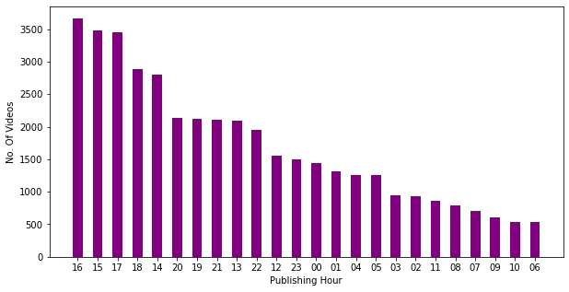
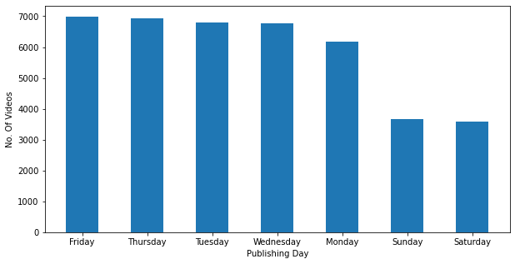
Dataset Overview
Dataset contains videos uploaded on YouTube in US during 2018 and 2019.
This dataset includes 40950 rows and 16 feature variables.
Most used words of Description are shown as word cloud.
Most uploads happen over weekdays and between 14:00 and 16:00

Slide 5
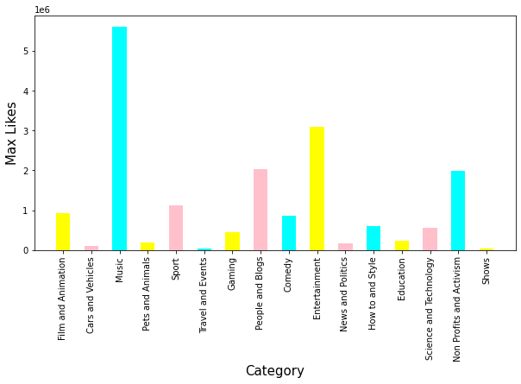
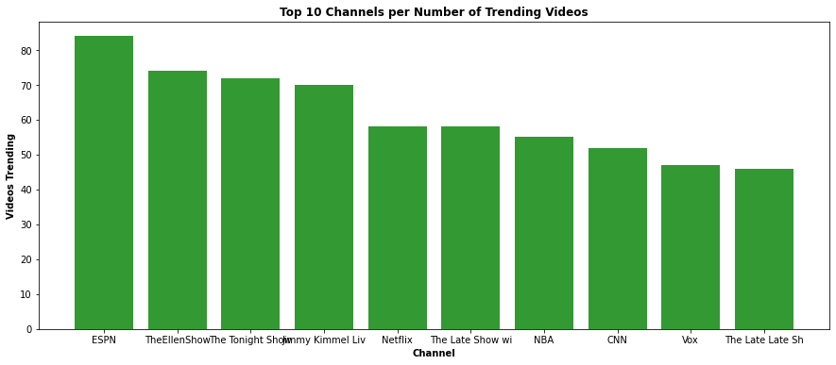
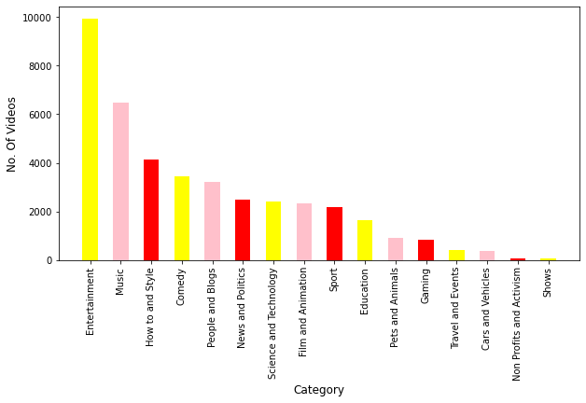
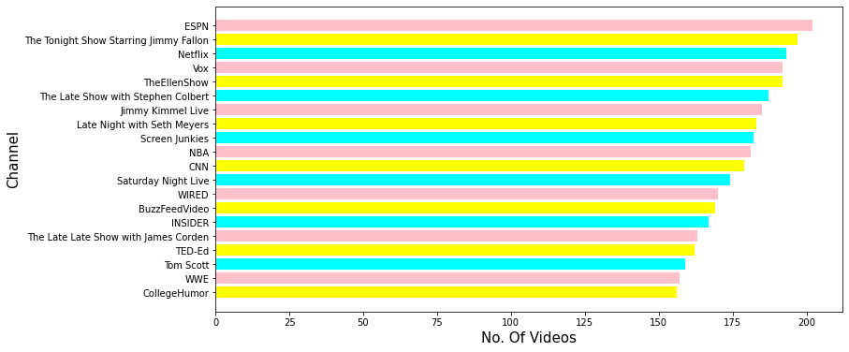

Slide 6
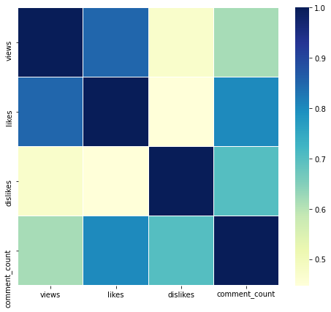
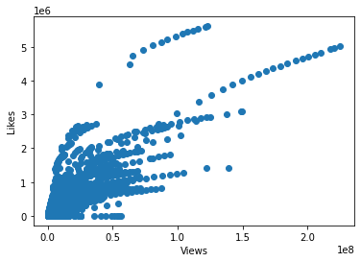
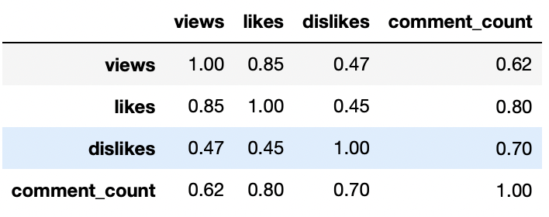
Correlation
Below graphs and chart shows correlation matrix.
Positive correlation between the number of views and the no of likes of a video.
Positive correlation between the number of views and the no of comments on a video.

Slide 7
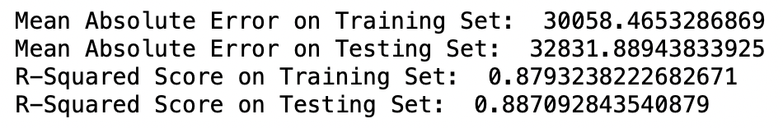
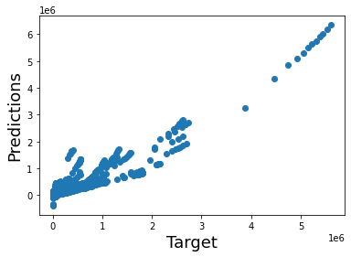
Predicting Likes
Number of likes is a continuous variable; hence we need to apply a regression model.
Linear regression results shows that r-squared score of 0.89.
Mean absolute error on training set with linear regression is 30058.
Graph on the right shows the evaluation of the linear regression model.

Slide 8
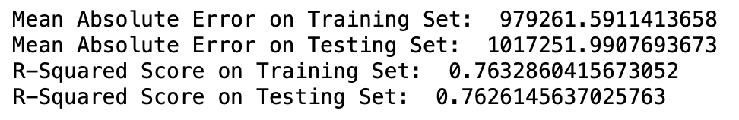
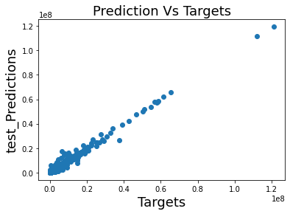
Predicting Number of Views
Linear regression model to predict number of views had a R-Squared score of .76 on training dataset.
Since linear regression is not accurate enough, I applied Random Forest Regressor.
Random Forest Regressor on predicting number of views Mean absolute error is 220924.75 which is much better compared to Linear regression.
Graph on the right shows the evaluation of the Random Forest Regressor model.

Slide 9
Conclusions
Linear Regression is a good fit when modeling to predict number of likes.
To predict the number of views, Random Forest Regressor has better score than linear regression.
Positive correlation between the number of views and the number of likes of a video. Like wise is the case with the number of views and the no of comments on a video.
The data set I worked with could have had few more attributes such comment text, length of the video, number of subscribers, etc.

Slide 10
References
J, M. (2019, June 3). Trending YouTube Video Statistics. Kaggle. https://www.kaggle.com/datasnaek/youtube-new.
Srinivasan, A. (2017, December 17). Youtube Views Predictor. Medium. https://towardsdatascience.com/youtube-views-predictor-9ec573090acb.
Dulanjani, Y. (2021, May 18). YouTube View Prediction with Machine Learning. Medium. https://medium.com/analytics-vidhya/youtube-view-prediction-with-machine-learning-fdd4f40f352d.
Applied Text Analysis with Python, Benjamin Bengfort, Rebecca Bilbro & Tony Ojeda
Machine Learning with Python Cookbook, Chris Albon

